Slide 1


The Effects of Sleep on the Brain
袁梦瑶 俞婧萱
王端端 夏雨桐

Slide 2
https://www.ypppt.com/
目 录
PART 1
Concept and significance
CONTENT
PART 2
Sleep impact the emotion brain
PART 3
The effects of memory on brain
PART 4
Sleep deprivation

Slide 3
Concept and significance
01
Concept of sleep
Why sleep is so important for brain health?
Foreign research theory support

Slide 4
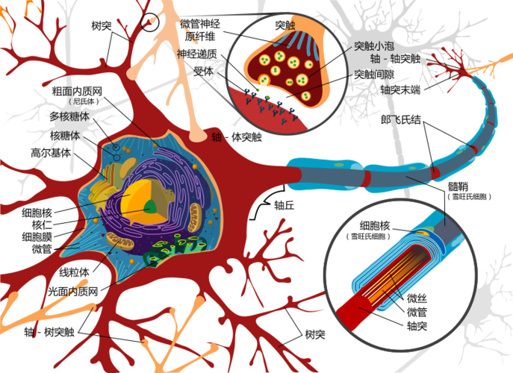
Concept
What is sleep?
By building and strengthening synapses — the connections between nerve cells, or neurons — the brain can also repair the small amount of daily nervous system damage (typically damage to genes and proteins inside neurons) and clear away accumulated byproducts.

Slide 5
Why sleep is so important for brain health
1
Sleep is necessary for the proper functioning of the nervous system.
meaning
2
In addition, deep sleep is associated with increased protein mass.
Sleep has been found to be invaluable for the memory of information, data, names, date formulas, for the further thinking of problems that have not been solved during the day, and even for those who need to repeat the practice of musical instruments, sports, and so on.
3

Slide 6
Most of all, it overturns our perception that we can only learn and solve problems when we are awake during the day, so many of us despise sleep and even take pride in sleeping less. In fact, sleep reduction is the most unscientific use of time, a lot of difficult problems are solved in sleep.

Slide 7
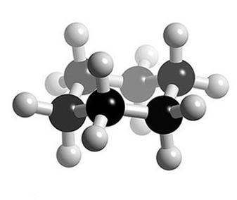
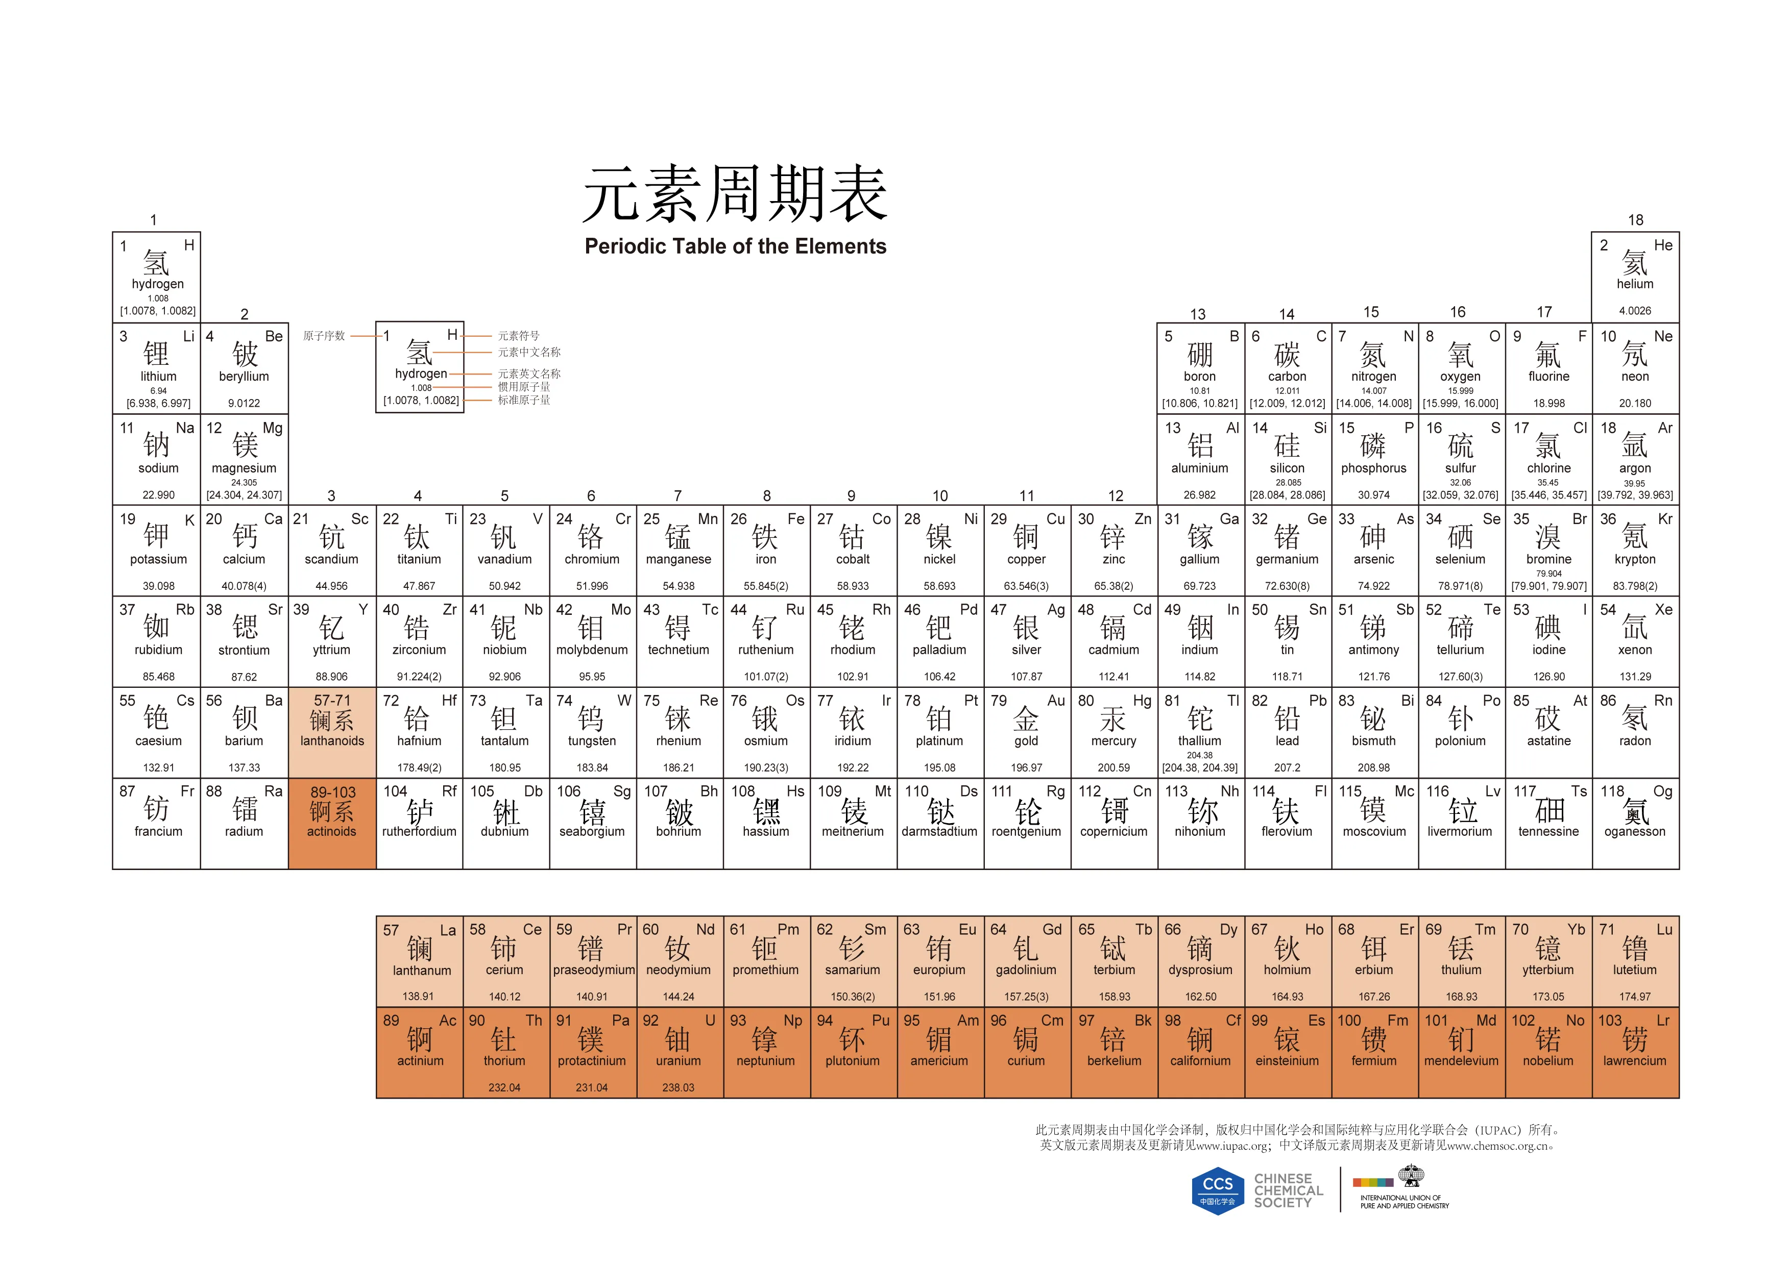
Forein report theory support
01
02
benzene ring
periodic table
We know the structure of the chemical formula, the benzene ring, from the German chemist Friedrich August Kekule, who discovered it in a dream.
The periodic table from the Russian chemist Mendeleev, who discovered it while he was sleeping.

Slide 8
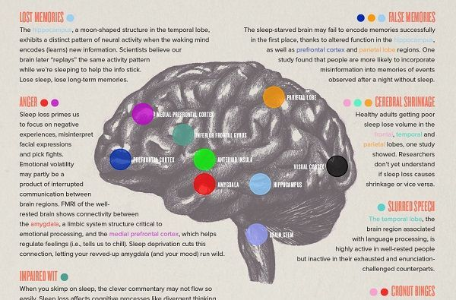
Brief summary
Sleep impact the emotion brain
Concept and significance
01
02
The effects of memory on brain
03
04
Sleep deprivation

Slide 9
02
Sleep Impact the Emotion Brain

Slide 10


Is it true?
and
How sleep impact our emotion brain?

Slide 11
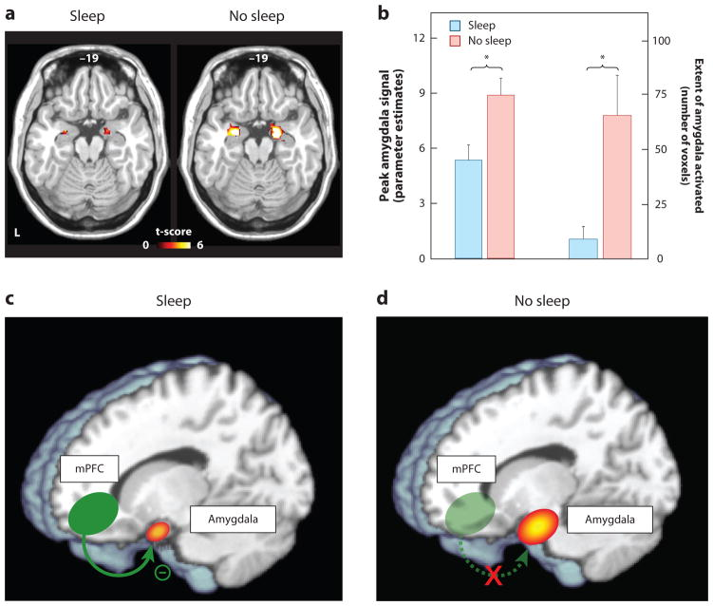
abnormol active
（https://www.ncbi.nlm.nih.gov/pmc/articles/PMC4286245/）（artical:The Role of Sleep in Emotional Brain Function .)(published in PMC)(author:Andrea N. Goldstein1 and Matthew P. Walker1,2,*)）

Slide 12


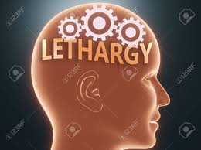
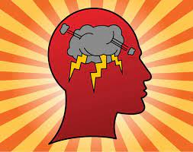

This influence will let our brain amplification nagative emotions by 60 percent!
upset
anger
fear
lethargy
impulsive

Slide 13
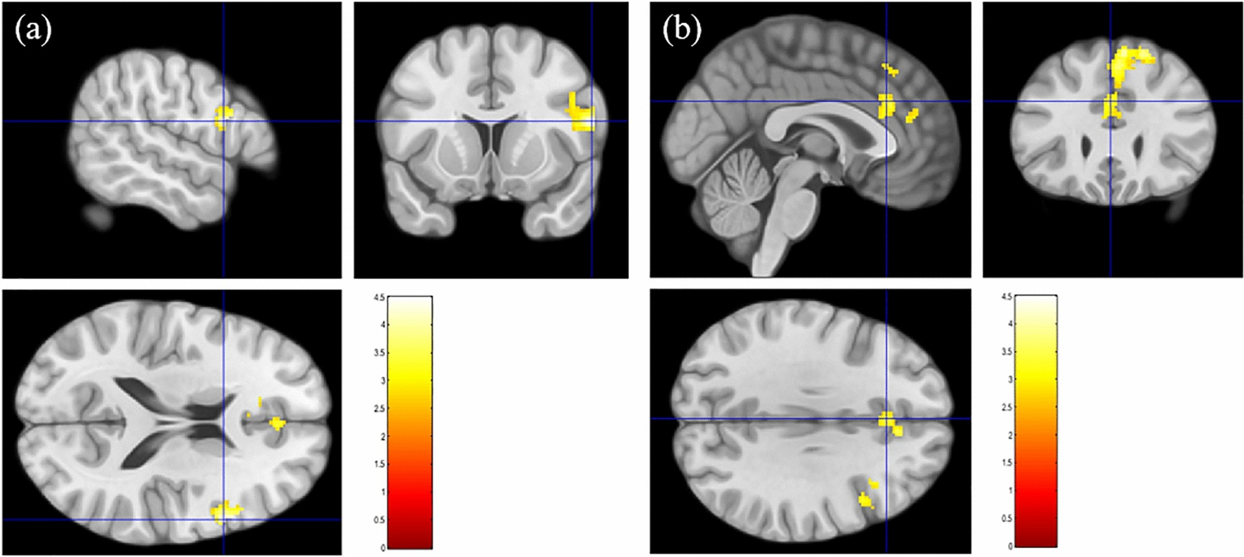




(degree of brain activity)
lack
sleep
enough
sleep
That will decrease your brain’s reactivity,emotion recognition and expression.

Slide 14
conclusion：sleep deprivation can truly impact our emotion brain by this chain
the fuction of the brain
sleep deprivation
(feel,intellect,
adjust,control)
feelings:
fear,upset,angry
intellection:
impulsive,lethargy
finally
to
by
emotion brain
the structure of the brain
(mpfc and amydala)

Slide 15
03
The effects of memory on brain
hippocampus
parietal lobe
prefrontal cortex

Slide 16
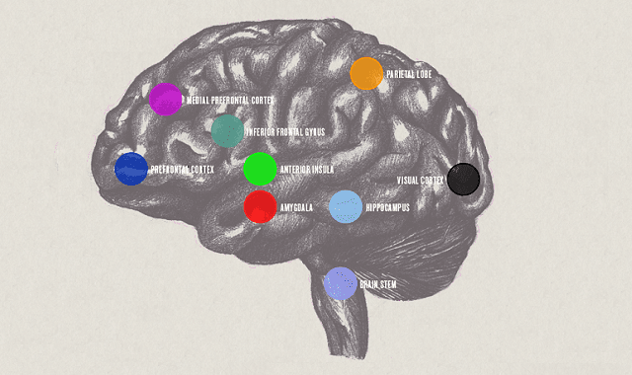
Retain memory Store memory correctly
1
Hippocampus
2
Parietal lobe
3
Prefrontal cortex
Notes:
https://www.ypppt.com/

Slide 17
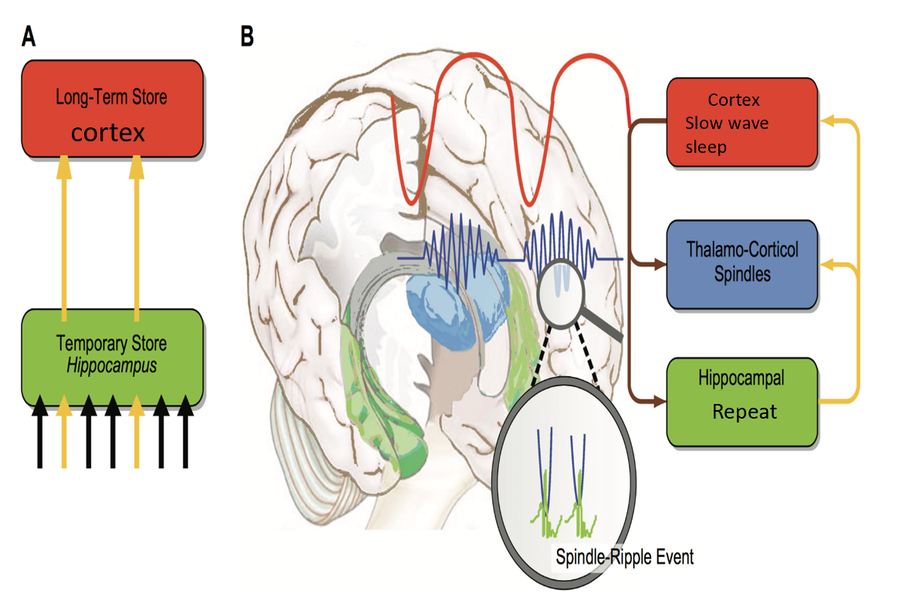
Retain memory
Active system consolidation
he information encoded in the cortex and hippocampus during waking is continuously activated and repeated during slow wave sleep

Slide 18


Store memory correctly
1
The study was conducted by a team from Michigan State University and the University of California, Irvine。
Process: Participants in the study were asked to watch and remember a series of images
2
3
Result: If a person stays up all night, many details are easy to make mistakes when remembering images, and the memory is easy to distort

Slide 19
04
Sleep Deprivation

Slide 20

The Graph
1
Cerebral Shrinkage
【脑萎缩】
The main cause of Alzheimer’s disease.
2
β Amyloid Protein【β淀粉蛋白】 Content
people with Alzheimer’s disease have more than 45 percent amyloid beta than their peers
3
A direct correlation between β amyloid and sleep duration.
The Difference Of 2 brains

Slide 21


What Will We Become?
Insufficient sleep is a public health problem,wherein marked brain network instability【脑网络不稳定】 seems to be a neural hallmark【神经特征】
of sleep deprivation

Slide 22
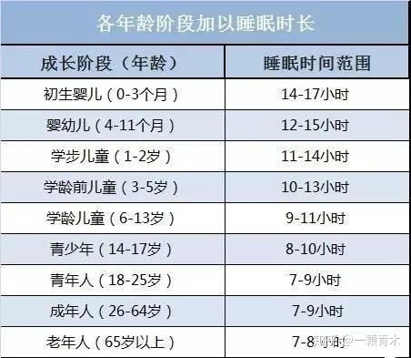
Relative Countermeasures
Have enough time to sleep
But the impairment of attentional networks will get worse after 1 night of sleep
deprivation.

Slide 23
Reference
01
Wulff, K., Gatti, S., Wettstein, J. G. & Foster, R. G. Sleep and circadian rhythm disruption in psychiatric and neurodegenerative disease. Nat. Rev. Neurosci. 11, 589–599 (2010).
02
Centers for Disease Control and Prevention. Insufficient sleep is a public health problem. CDC https://www.cdc.gov/features/dssleep (2015).
03
Rasch, B.,& Born, J. (2013). About sleep's role in memory. Physiological Reviews, 93(2), 681-766.
04
Kriszenblat, L. (2018). Why our brain needs sleep, and what happens if we don' t get enough of it. InnerSelf. https://innerself.com/content/living/leisure
05
Shao, h. (Executive Producer). (2021). When dreaming, the brain is playing Speed Linkup [Audio podcast]. Dedao.
06
Gordon B.,& Diekelmann, S. (2015). Sleep smart-optimizing sleep for declarative learning and memory. Frontiers in Psychology.

Slide 24
Thank you for listening!
袁梦瑶，俞婧萱
王端端，夏雨桐

